Slide 1
Spatial and Temporal Analysis of Shoreline Cleanup Data
Team: Carol Yang, Farhad Kazi, Jessie Giddings, Johanne Lemaire, Kacy Wu, Shubham Negi, Stephen Wu, Yana Pertels

Slide 2
Assumptions
Do we pollute more in the summer months?
Are the most populated cities the most polluted?
Is plastic waste growing the fastest?
Notes:
Or, more clean-ups in the summer, because outside BC the rest of the year is freezing?

Slide 3
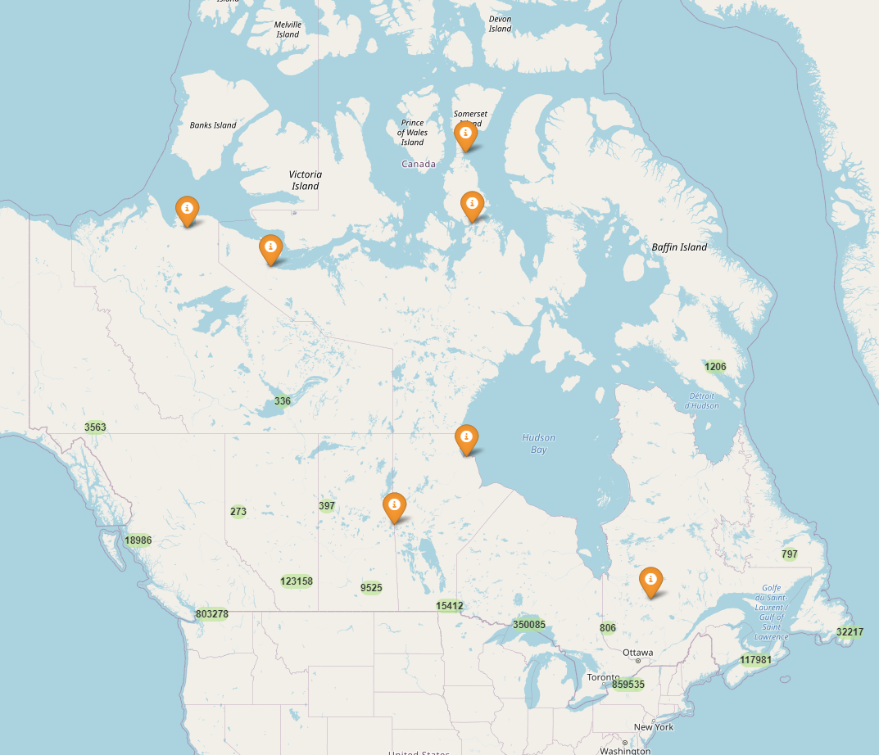
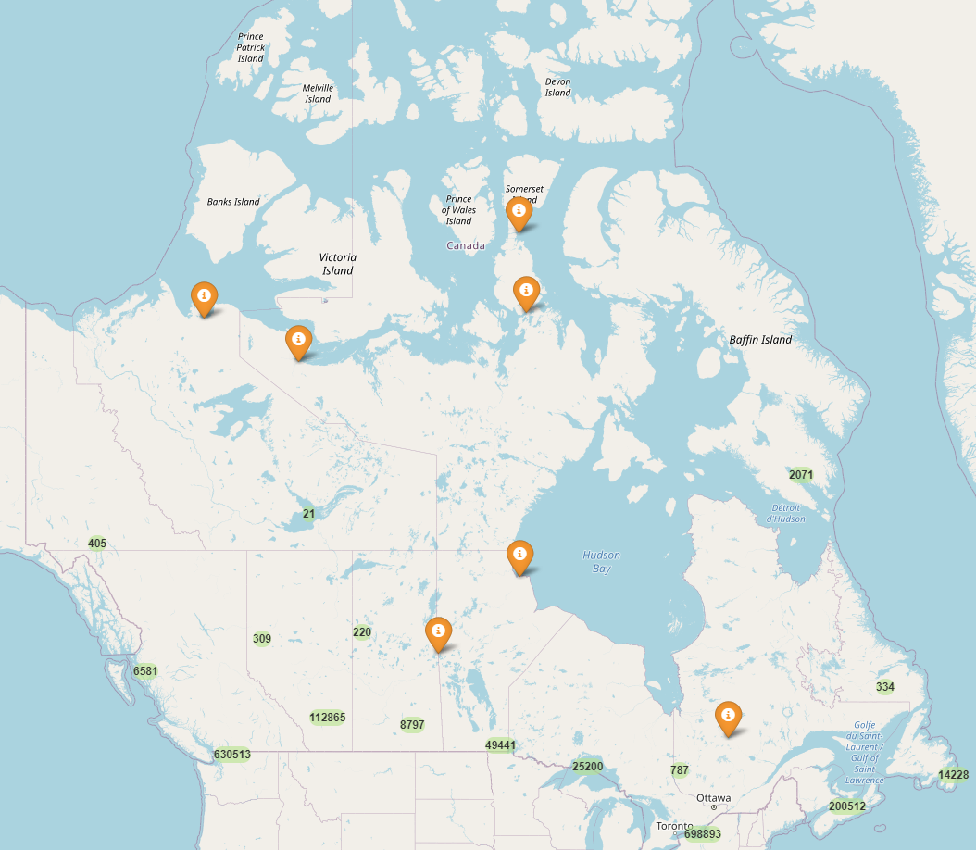
Spatial Analysis
Plastic Waste
Non-plastic waste

Slide 4
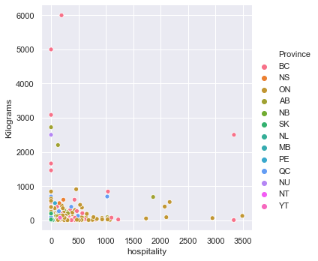
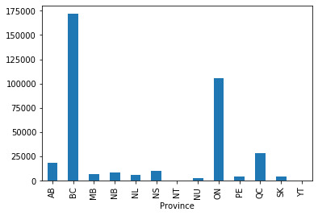
Provincial Ocean Waste Trends

Slide 5
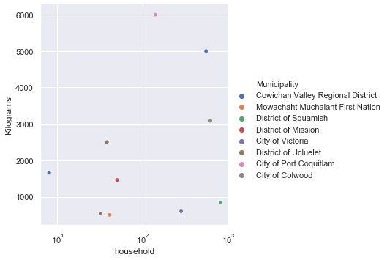
Ocean Pollution trends in BC
Top 10 highest pollutants in 2017

Slide 6
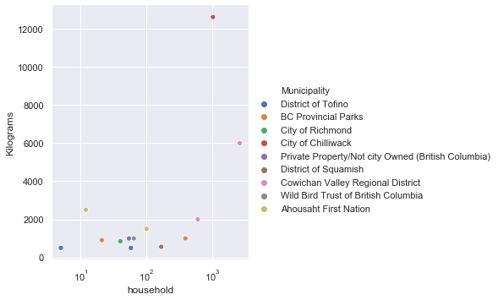
Top 10 highest pollutants in 2018

Slide 7
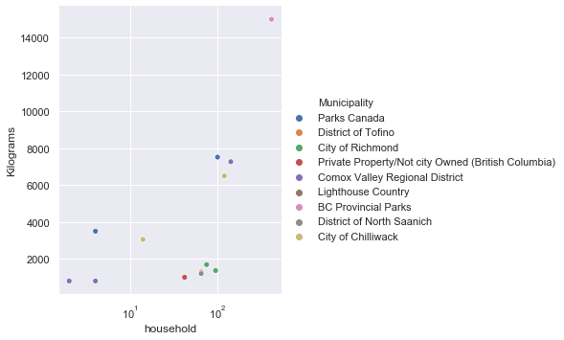
Top 10 highest pollutants in 2019

Slide 8
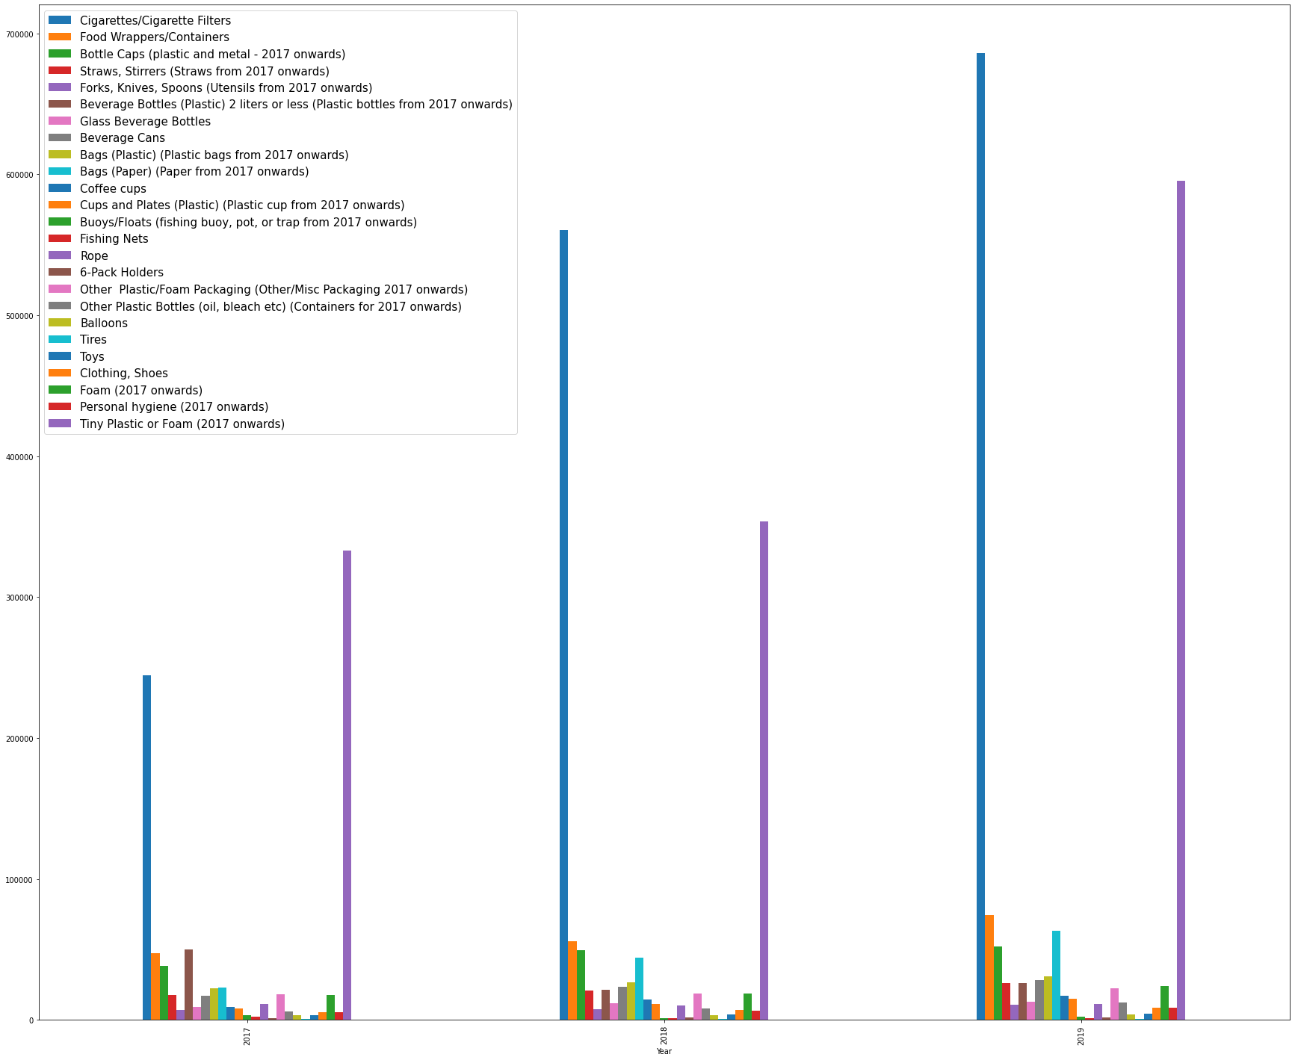
Temporal Analysis
In 2017 and 2018, there were similar amounts of Tiny Plastic waste found.

Slide 9
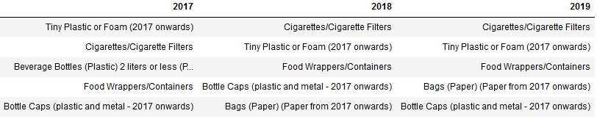
Most Common Sources of Waste

Slide 10
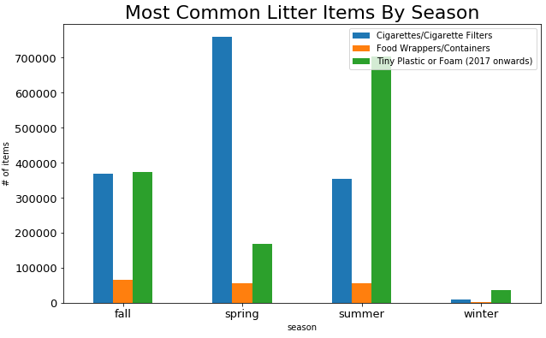
Seasonal Trends In Waste Sources

Slide 11
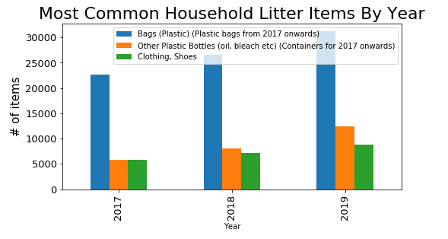
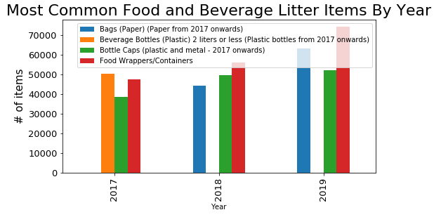

Slide 12
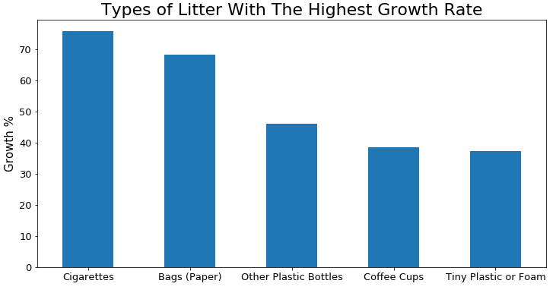
Which Types of Waste Have We Been Seeing More Of?

Slide 13
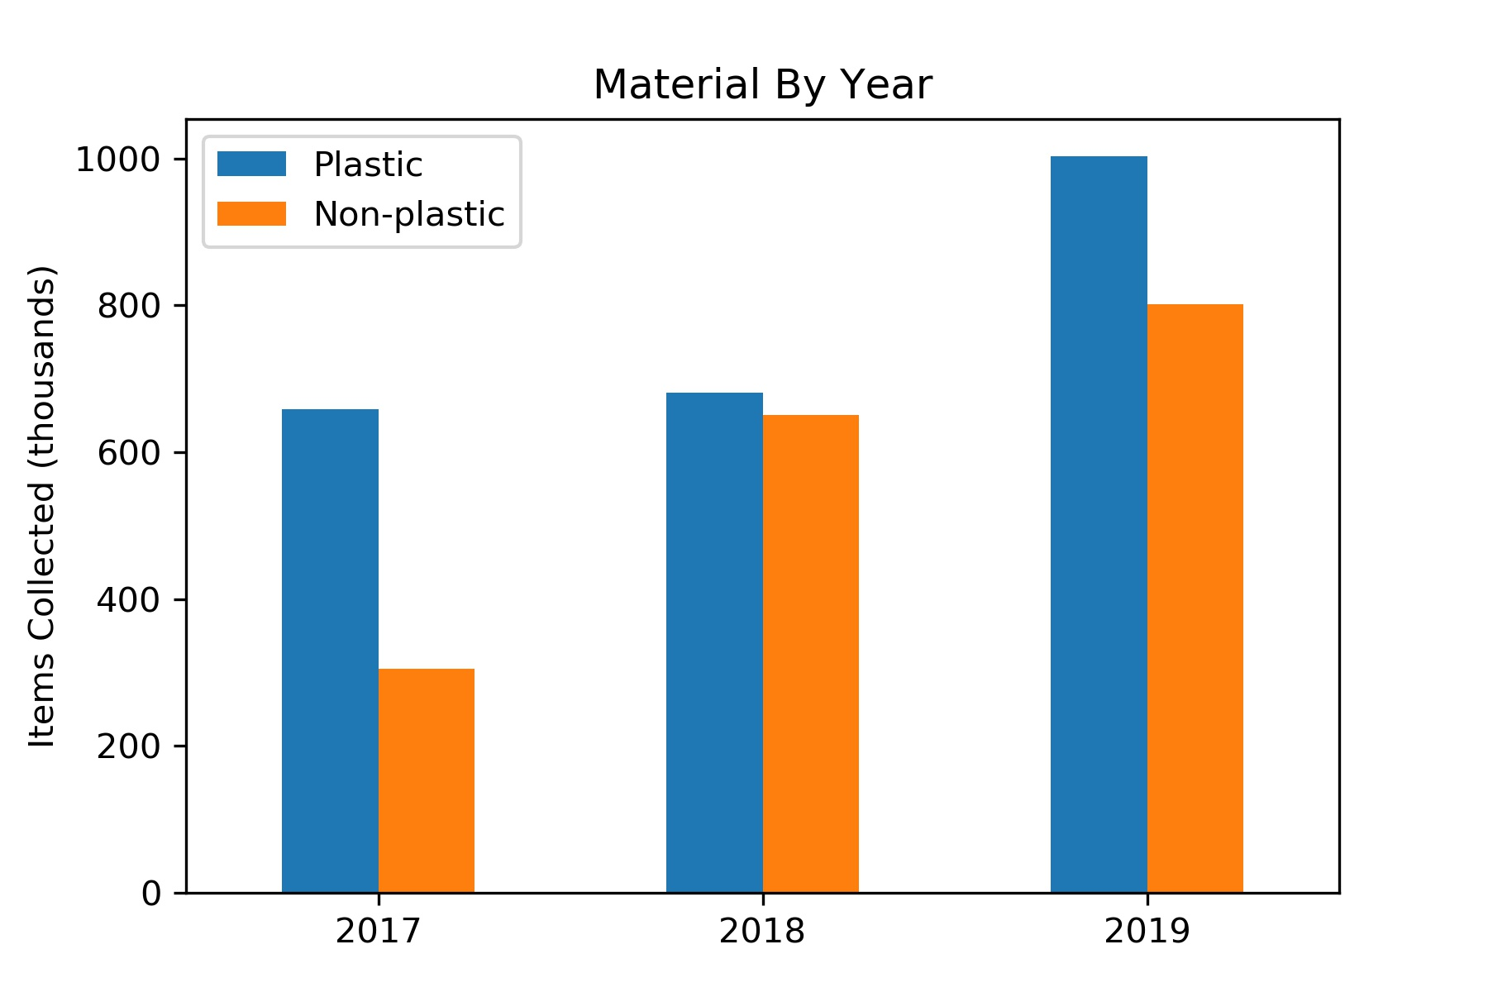

Slide 14
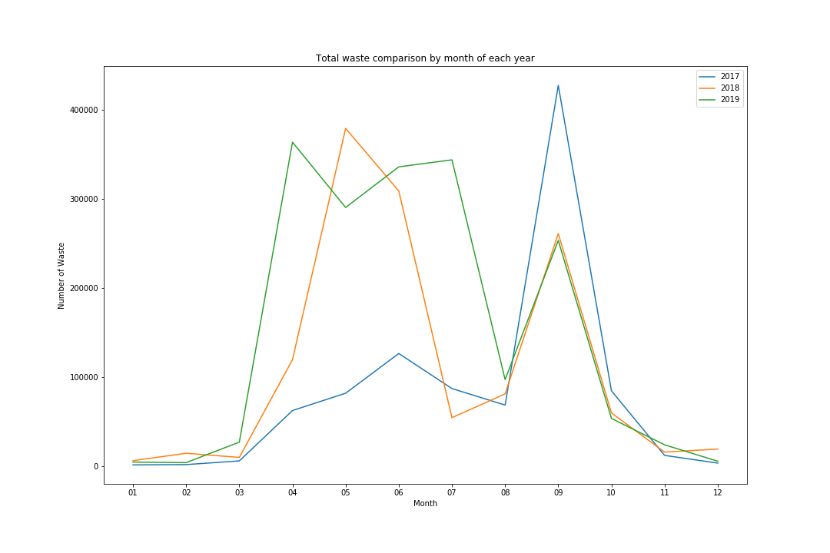
Pollution trends by month
Total amount of waste compared by month of year 2017, 2018 and 2019
Number range too wide, spanning from 0 to 400000
Notes:
We did analysis on pollution trends by months. This plot is months against the total amount of waste for each year.
But the number range is too wide spanning from 0 to 400 thousand. So

Slide 15
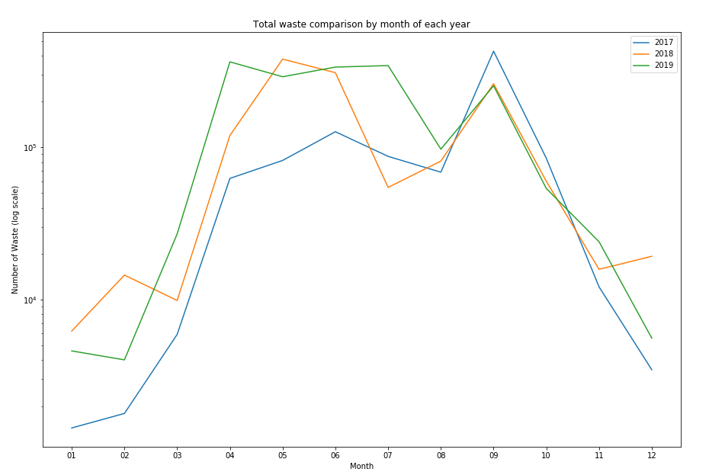
Pollution trends by month
Total amount of waste compared by month of 2017, 2018 and 2019 on a log scale
It seems that the number is increasing gradually each year
It seems that summer has more waste than non-summer
But are these two assumptions true?
Notes:
So we plot the amount of waste in log scale to see more clearly.
From the plot, it seems that the number is increasing gradually each year and that summer has more waste than non-summer.
But are these two assumptions true?

Slide 16
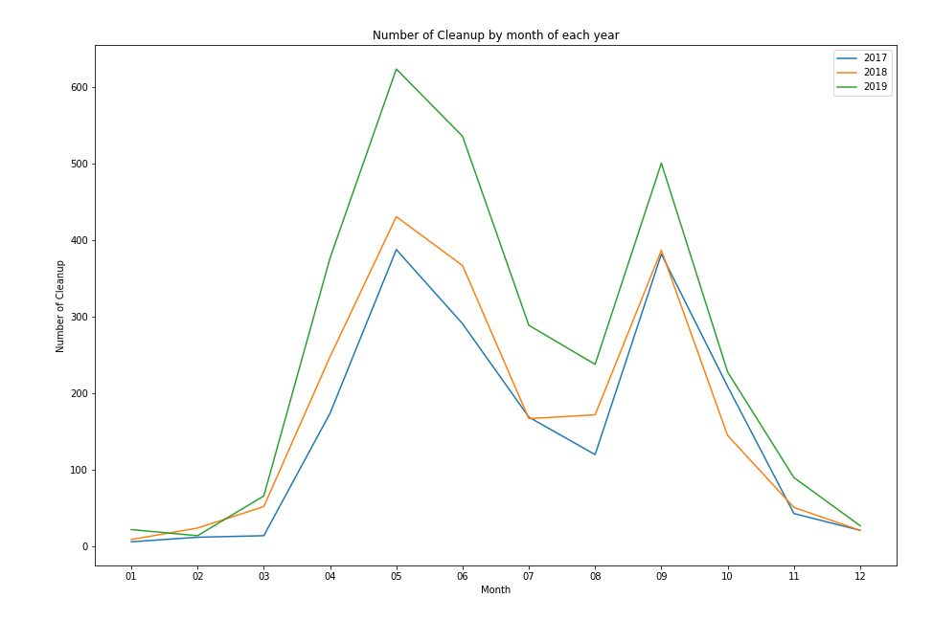
Pollution trends by month
Number of cleanup events compared by month of year 2017, 2018 and 2019
2019 has more cleanup events therefore its total amount of waste is larger
Notes:
First assumption. The number increasing each year is probably caused by difference in the number of cleanup events.
We plot months against number of cleanup events and found that 2019 has more events therefore it has larger total amount of waste.

Slide 17
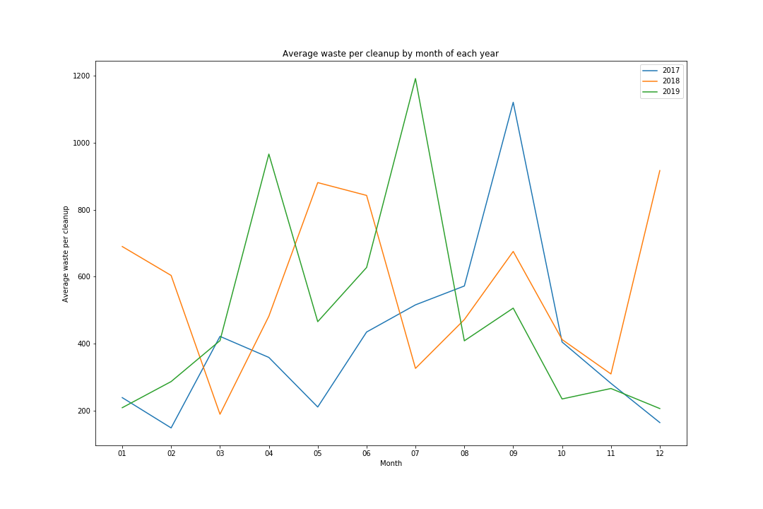
Pollution trends by month
Average amount of waste (total amount divided by number of cleanup events) compared by month of year 2017, 2018 and 2019
There are no obvious patterns regarding summer vs non-summer average waste, therefore we cannot draw the conclusion that summer has more waste
Notes:
Second assumption. Summer has more waste than non-summer period.
We introduced average waste which is total waste divided by cleanup events.
If summer truly has more waste, we should see summer average waste larger.
But from the plot, there are no obvious patterns regarding summer vs non-summer average waste.
Therefore this assumption cannot be easily drawn.

Slide 18
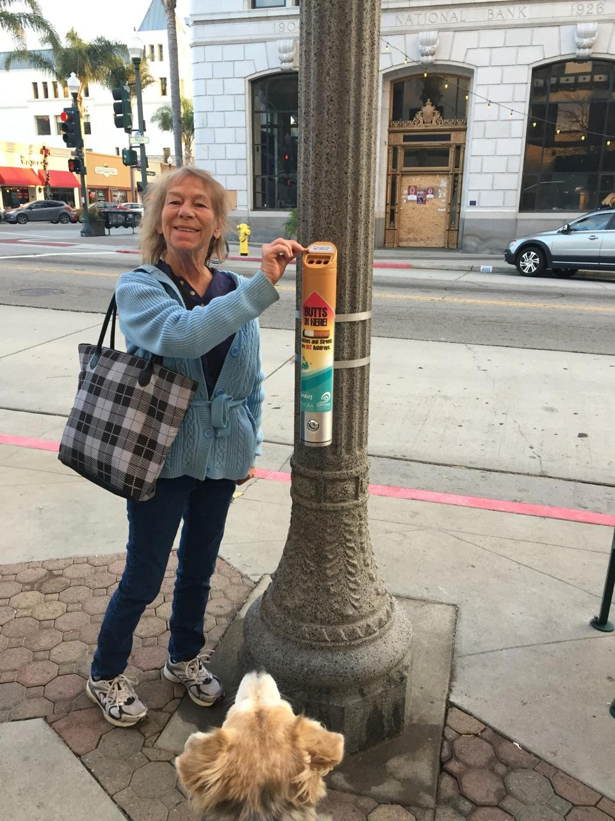
Recommendations
Install more Cigarette Litter bins.
Raise awareness on Paper Bags waste.
Increase shoreline cleanups in less densely
Populated cities and provinces.
Encourage people to cleanup during winter.
Cigarette Bins (photo credit: Surfrider Foundations)
Notes:
Cigar bins and paper bags Higher growth rate.
most populated cities the most polluted?
Sum up
In 2011 a research paper produced by the Northern Ireland Assembly said it takes more than four times as much energy to manufacture a paper bag as it does to manufacture a plastic bag.
Also, Paper bags also weigh more than plastic; this means transportation requires more energy, adding to their carbon footprint, the study adds.

